Slide 1


CONNECTICUT
Working Green
Conserving Energy and Water
Eliminating Toxic Chemicals
Reducing Waste
June 2014

Slide 2
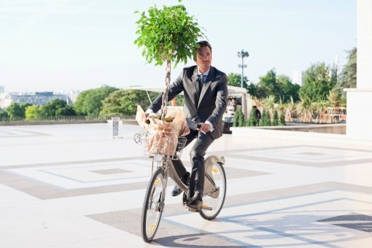
AGENDA
Where are we now
Where we are going
Investing in a greener future
Sustainable
Composting
Recycling
Carbon Footprint

Slide 3
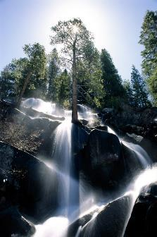
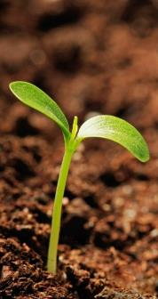

PHASE I
Where We Are Now

Slide 4
Core Values
Powering the Factory
Manufacturing
Using a Product
Recycling a Product
Sourcing New Materials
Providing cost-effective solutions with transparent, sustainable operations is a core value of C&C Janitorial Supplies.
We understand that the way to reduce impact on the environment is to look at the entire product life-cycle.

Slide 5

Staying Ahead of the Curve
Powering the Factory
Manufacturing
Using a Product
Recycling a Product
Sourcing New Materials
Through our affiliation with the Biodegradable Products Institute, we are able to stay informed of the benefits and availability of biodegradable and compostable materials.

Slide 6






















We Partner with Those Who Share Our Focus
Powering the Factory
Manufacturing
Using a Product
Recycling a Product
Sourcing New Materials
We align with key manufacturers that have proven consistent sustainability work and performance to further the use and recovery of biodegradable materials and to promote the harmonization of standards.

Slide 7
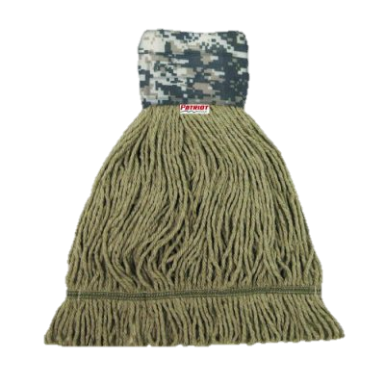
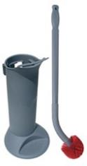
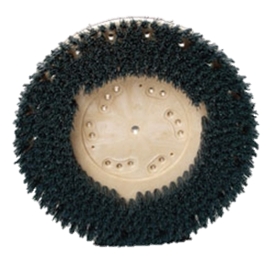
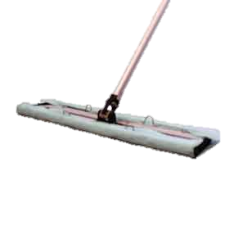
The Future of Green Cleaning Performance
Powering the Factory
Manufacturing
Using a Product
Recycling a Product
Sourcing New Materials
As more forward-thinking advancements which address environmental concerns are presented, we plan to take full advantage of new, sustainable opportunities.

Slide 8




Sustainability at Work
Powering the Factory
Manufacturing
Using a Product
Recycling a Product
Sourcing New Materials
We are committed to the environment and support sustainability programs like Georgia Pacific’s Green by Design - Reduce, Reuse, Recycle program.

Slide 9
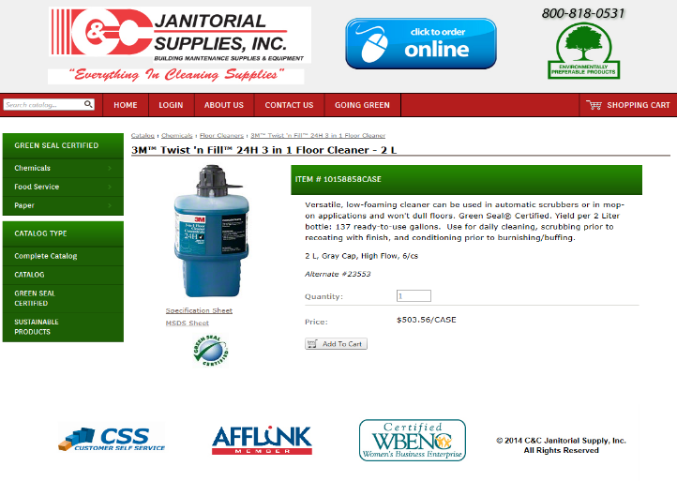
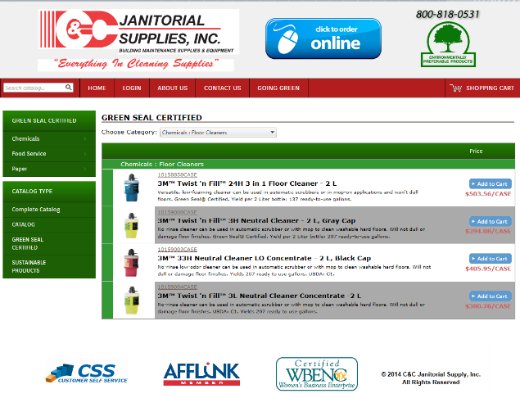
Click to Order Online
We have simplified our online catalog order entry access to identify “Green Seal” and other green certifications for customer ease.

Slide 10
Easy to Follow Reporting

Slide 11



PHASE II
Where We Are Going

Slide 12
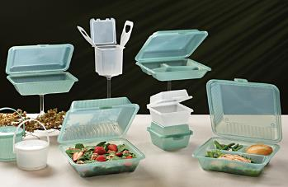
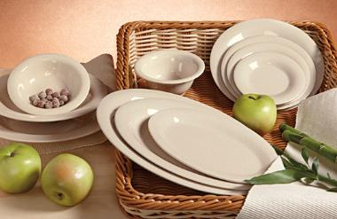
Sustainability At School
100% BPA Free
Commercial Dishwasher Safe
Highly Durable Polypropylene
Microwave Safe for Re-Heating
Leak-Resistant Designs
Stackable
Customizable
Reusable & Recyclable (#5)
100% BPA Free
Break-Resistant Melamine
Commercial Dishwasher Safe
Break-Resistant Melamine with Bamboo Fiber
Reusable and Biobased, Constructed for Multi-Use Commercial Applications

Slide 13

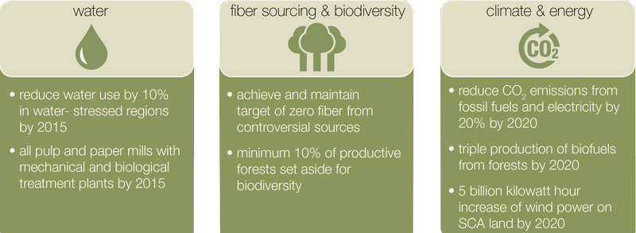
Sustainability Targets
Providing cost-effective hygiene solutions with transparent, sustainable operations is a core value of SCA . . .

Slide 14

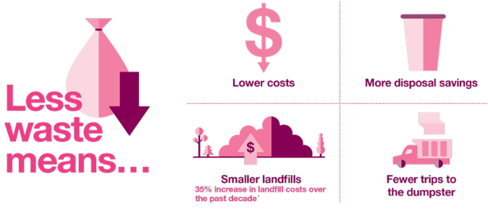


Sustainability in Action
Naturalize: Minimizes its environmental footprint along every step of the product lifecycle—from design and manufacturing to delivery and use.
Socialize: Solutions help attract and retain customers while boosting employee satisfaction and morale.
Capitalize: Innovative dispensing solutions reduce consumption and labor, leading to more cost savings

Slide 15
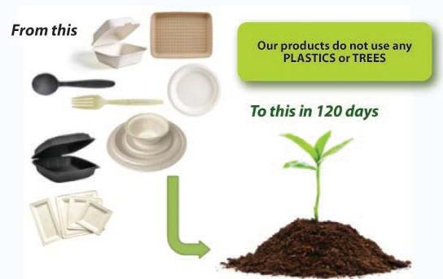


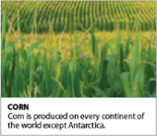

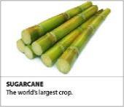
Environmentally
Friendly Tableware
Green Wave compostable and biodegradable products are made of health-friendly, sustainable natural fiber, such as sugarcane, bamboo, grass and reed plasma.

Slide 16

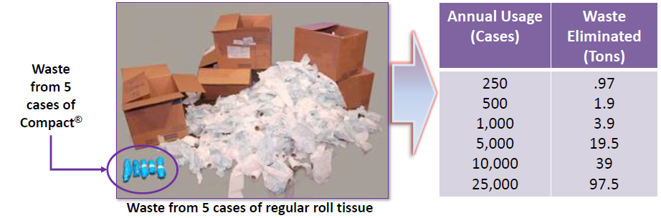
Environmentally
Positive
Compact® Coreless Tissue saves up to 7.8 pounds of waste compared to standard roll tissue products

Slide 17

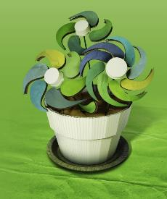
Recycling Simplified.
GP Harmon delivers customized & dynamic solutions that are environmentally & economically rewarding.
  Purchasing baled recyclables from DCs and/or baled recyclables at store level
  Utilizing GP freight network for natural backhaul optimization
  Managing multi-commodity bales as well as loose recyclable commodities
  Providing balers & collection equipment

Slide 18

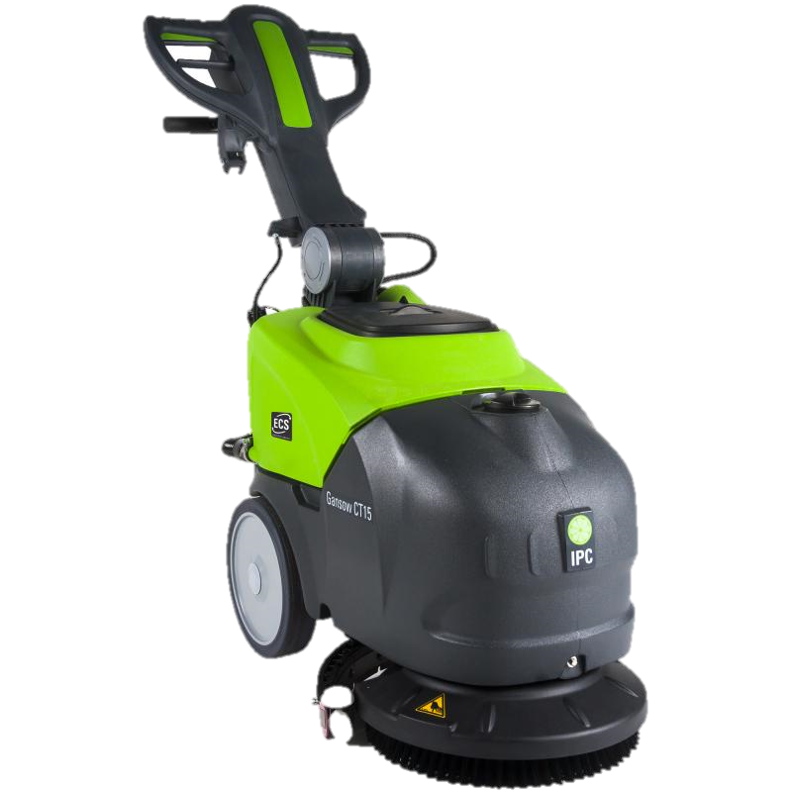
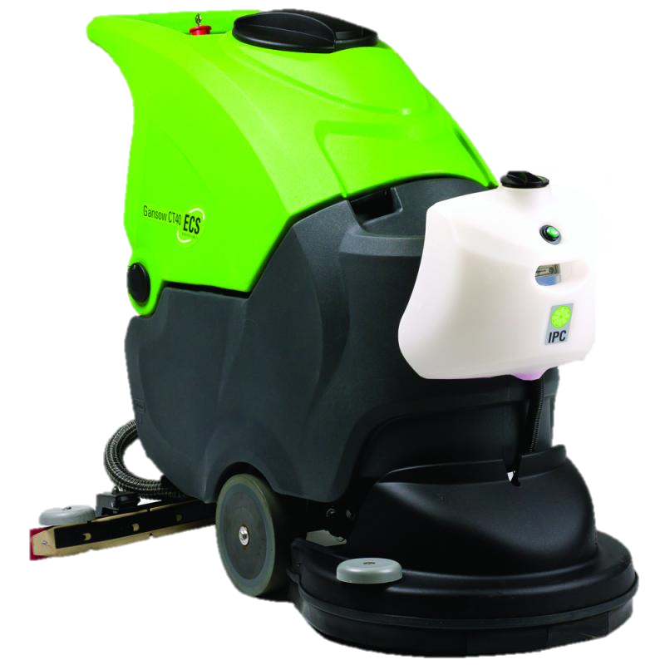
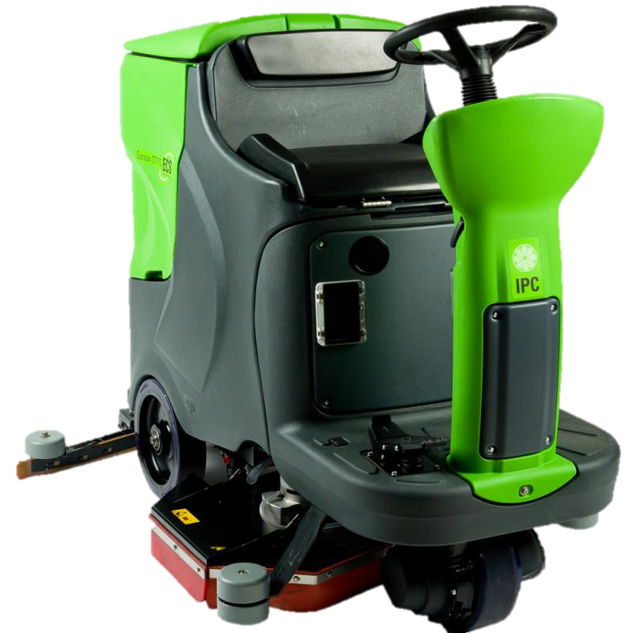
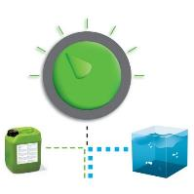
The Ultimate Green Cleaning Machines
Reduce Water Consumption 80%-90%
Reduce Chemical Consumption up to 80%-90%
Reduce Labor Time up to 30-50%
High Precision Mixing System:
Reduces detergent use to a minimum
Works with water regulation system of the machines to save water and detergent

Slide 19

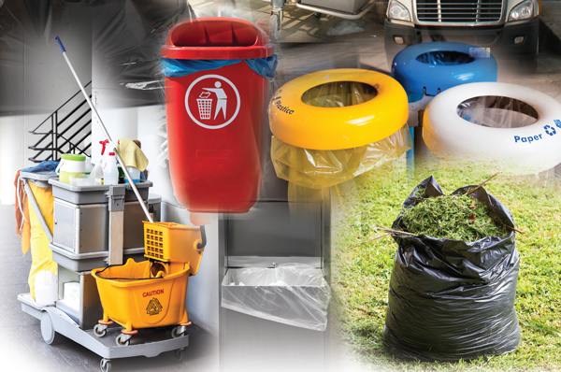
Oxo-Biodegradable
Can Liners and Garbage Bags
Bio-degradation reduces the enormous waste volume from 100% down to 15% to 20% as the plastic is converted into CO2 , water and biomass.

Slide 20




Environmentally Preferred Carpet Cleaning System
With HOST there is no water to heat and you don’t need blowers or air conditioning to dry the carpet. There is no smarter or “greener” way to clean.
According to industry estimates, there are about 200,000,000,000 square feet of carpet in the United States. Cleaning all of this carpet just once with HOST would save9,770,000,000 gallons of water!
That’s enough water to:
Fill 195,000,000 standard bathtubs
Flush a 1.6 gallon toilet more than 6,000,000,000 times
Sustain over 53 million people for one year or over 670,000 for their lifetimes

Slide 21
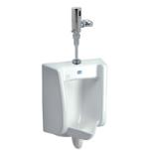


Innovation Will Shape the Future of Our Planet
The Zurn suite of sustainable, green products include 1/8 gallon ultra low flow urinals, high-efficiency (HET) pressure-assist toilets, 1.28 gpf ultra low flow flush valve fixtures, and much more!
Committed to preserving resources while creating products that help the construction community build a better world.

Slide 22


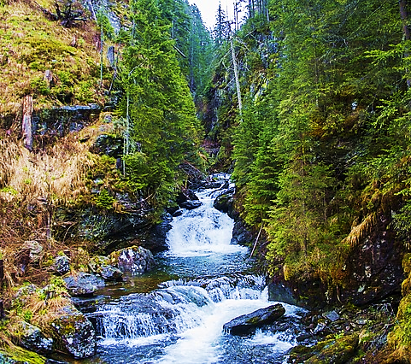
PHASE III
Investing in a Greener Future

Slide 23
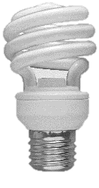

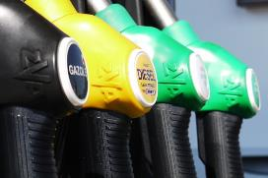
Switch on the Savings
Powering the Factory
Manufacturing
Using a Product
Recycling a Product
Sourcing New Materials
Our warehouse is Energy Star rated and equipped with sensor-activated lighting.
Our fleet is diesel energy-efficient with vehicles getting an average 42-43 MPG.

Slide 24

Bridging the Gap Between Chemistry & Sustainability
Waste Disposal
Over 65% of our waste is recycled, rather than landfilled
Over 250 tons of materials recycled annually
Recycling Program for production, office and employee waste
Sustainable Packaging
Save 60 tons of virgin plastic resin annually through use of a lower weight plastic container
Estimated environmental savings based on one year for corrugated cardboard production
Trees conserved -14,185
GHG conserved - 1087 metric tons
Energy conserved - 7444 million BTUs
Water conserved - 5,840,800 gallons
Wastewater creation avoided -7,429,929 gallons
Landfill space saved - 2754 cubic yards
.

Slide 25










665 New Britain Avenue, Newington, CT ▪ 1-800-818-0531 ▪ www.ccsupplies.com
Diversity vendors partnering and creating solutions that work.
Our presentation was prepared by Jantris Marketing Services, LLC – A Certified Minority Business Enterprise

